Slide 1
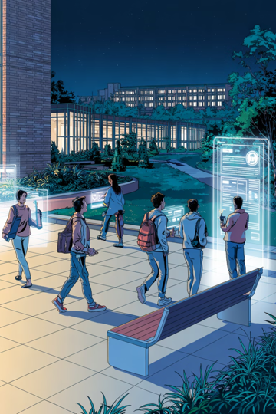
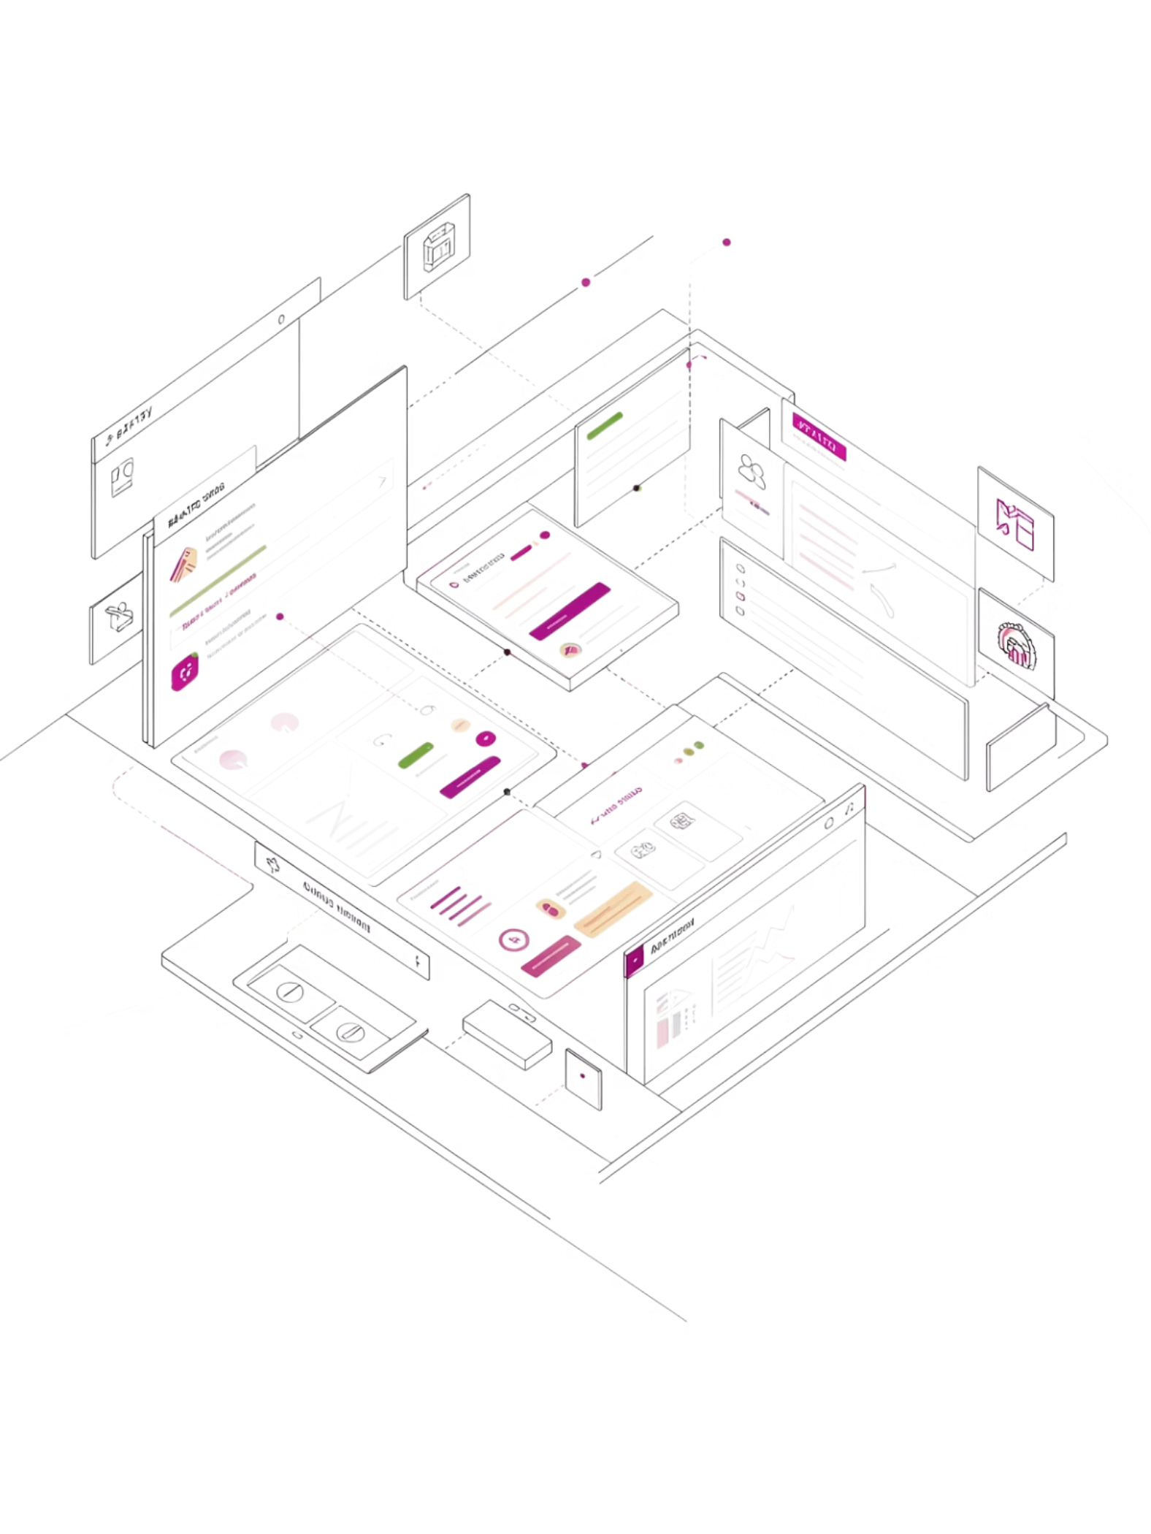
BrainyCampus
Smart Academic Management System
JAYPEE University Anoopshahr
Presented By:
Srishti — 8825501002
Kajal Kumari — 8825501013
Project Guide: Mr. Rahul Gupta

Slide 2
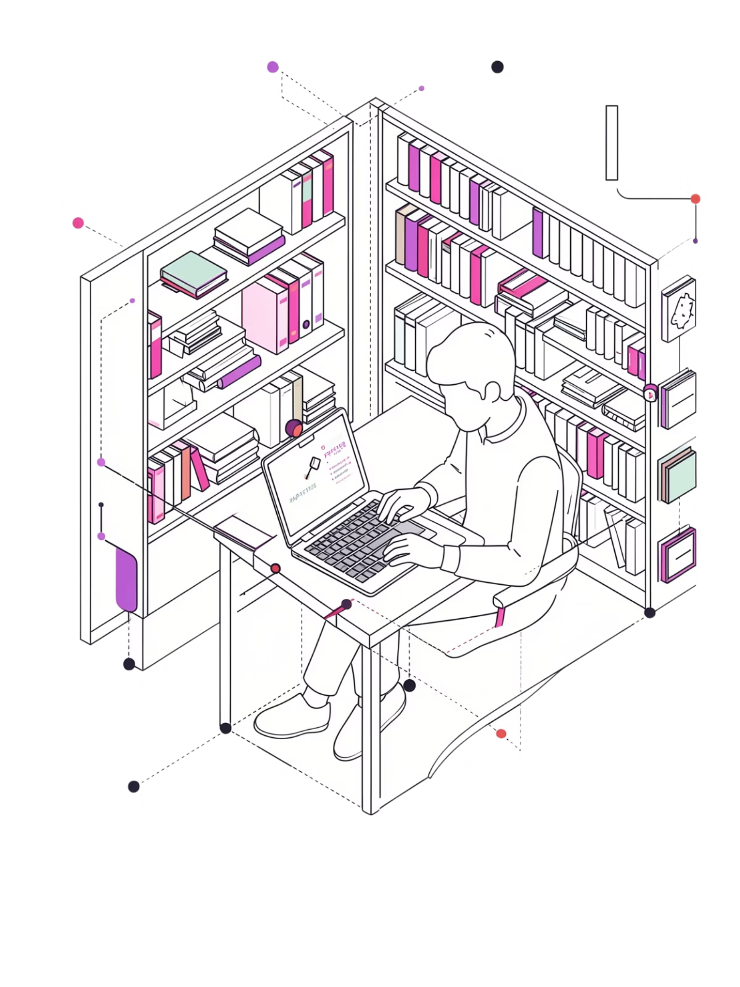
Introduction
Traditional academic systems are fragmented — students and faculty juggle separate platforms for attendance, assignments, notes, and timetables. Manual record-keeping consumes valuable time and reduces overall productivity.
The Problem
Disconnected tools, manual processes, and poor data organisation create friction for students and institutions alike.
The Solution
BrainyCampus is a centralised digital platform that unifies every academic activity into a single, efficient system.

Slide 3
Problem Statement
Current academic environments suffer from a range of operational inefficiencies that hinder student and faculty performance.
Manual Record Management
No Centralised Platform
Paper-based records are error-prone, time-consuming, and difficult to retrieve.
Multiple disconnected tools lead to data silos and inconsistent information.
Assignment & Attendance Gaps
Poor Time Management
Tracking deadlines and attendance manually leads to missed work and disputes.
Students struggle to plan exams, classes, and study schedules without a unified tool.

Slide 4

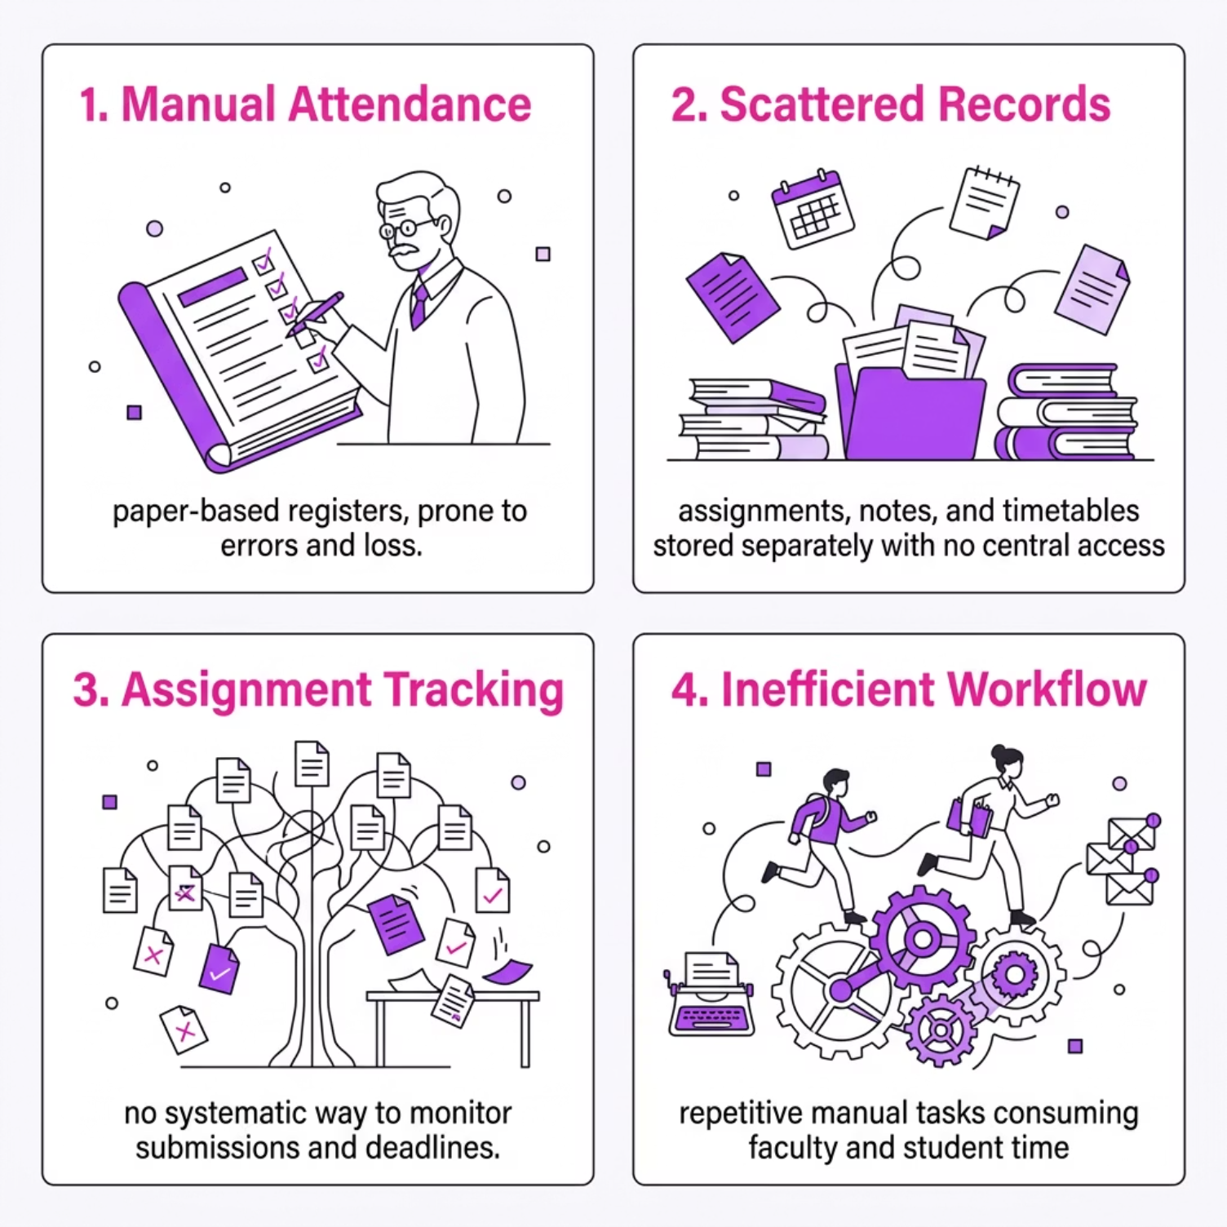

The Challenge We Are Solving
Why It Matters
Traditional academic administration relies heavily on manual processes — paper registers, disconnected spreadsheets, and informal communication. This leads to data inconsistency, lost records, and significant time wastage for both students and faculty.
Without a centralised system, critical academic data remains vulnerable, inaccessible, and difficult to audit.

Slide 5

OBJECTIVES
What BrainyCampus Sets Out to Achieve
Simplify academic management
Replace fragmented workflows with one unified platform.
Improve student productivity
Reduce administrative overhead so students focus on learning.
Enable secure role-based access
Students and admins access only relevant modules.
Digitise academic records
All data stored securely, accessible anytime.

Slide 6
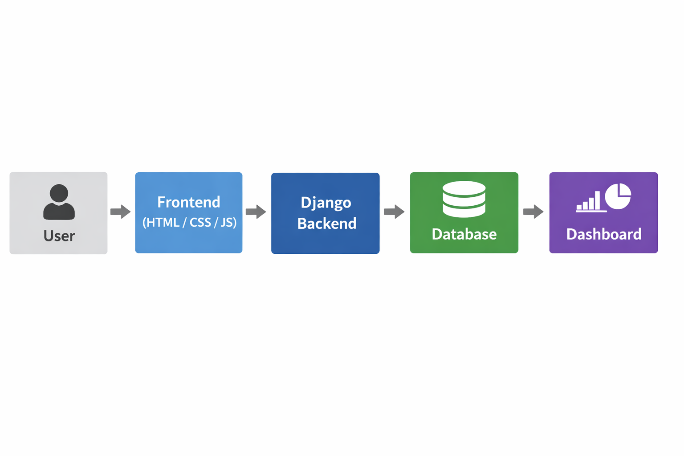




TECHNOLOGY STACK :
Built With Modern, Proven Technologies
Frontend
Backend
Database
Tools
HTML5 · CSS3
Python · Django Framework
SQLite
GitHub · VS Code
Responsive, cross-browser compatible UI with clean modern design
Robust MVC architecture with built-in authentication and admin panel
Lightweight relational database with Django ORM integration
Version control, collaborative development, and professional debugging

Slide 7
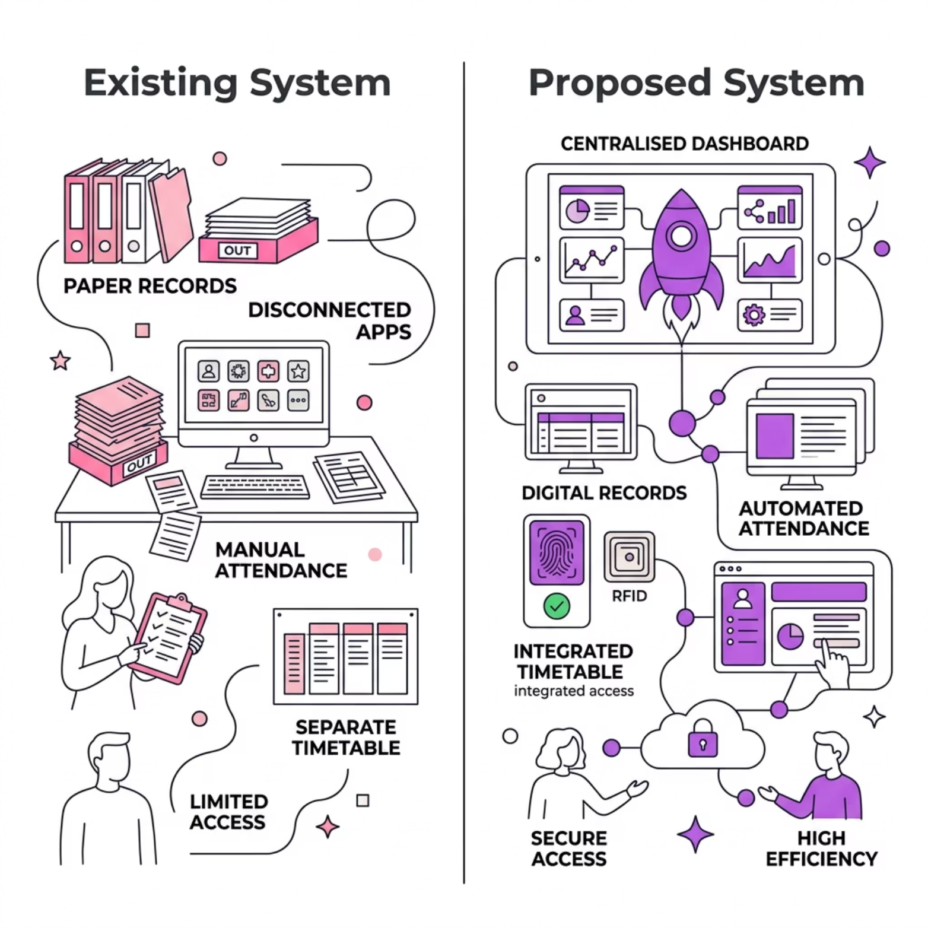

Existing vs. Proposed System
Why Change Is Needed
Traditional systems were built for a pre-digital era. They create data redundancy, consume staff time, and offer no real-time visibility into academic progress.
BrainyCampus addresses each pain point with a modern, integrated approach — replacing paper trails with live dashboards and automated workflows.

Slide 8
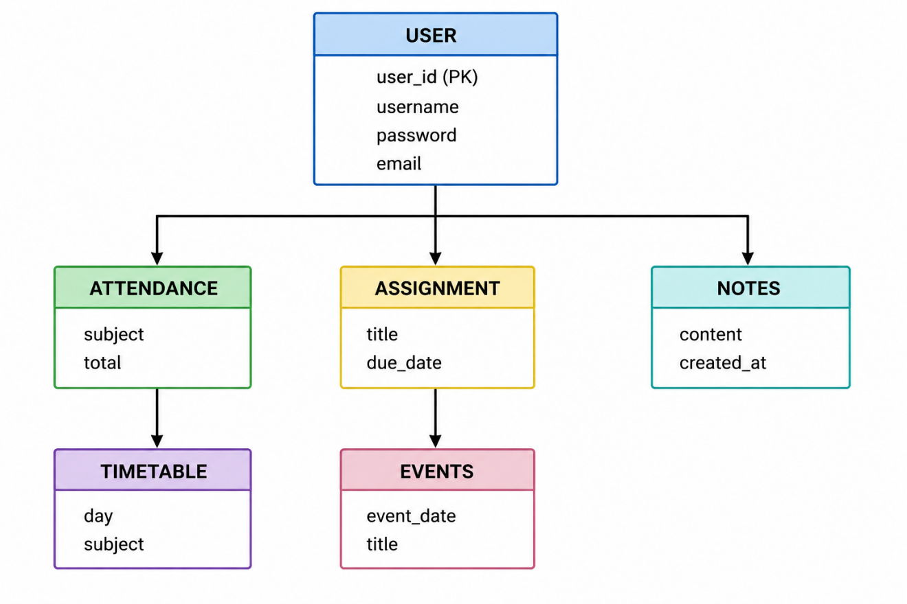
ER DIAGRAM :

Slide 9
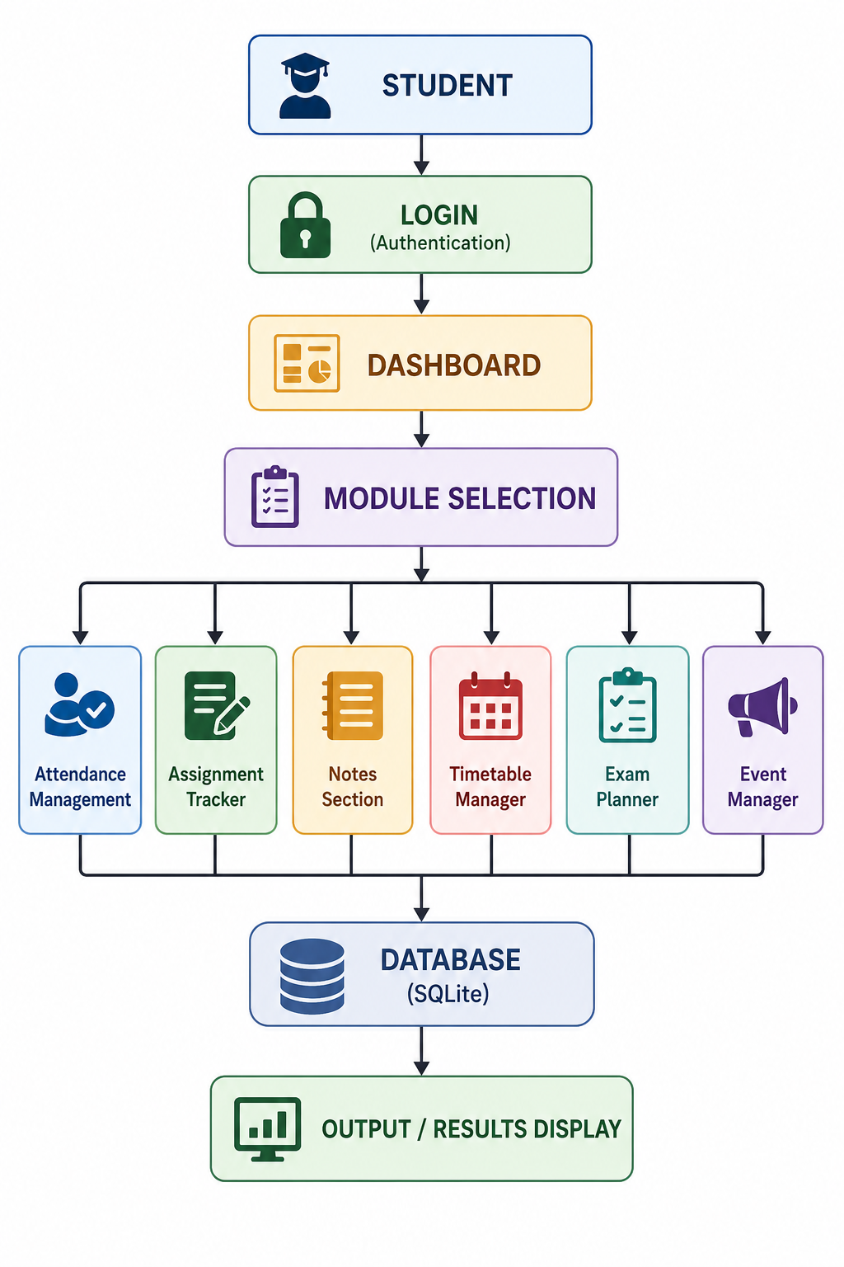
BASIC SYSTEM FLOW DIAGRAM

Slide 10

Core Modules
Attendance Management
Assignment Tracker
Record and review daily attendance; generate reports per subject or date range.
Create assignments with deadlines; track completion status and submission history.
Notes & Notebook
Exam Planner
Upload, organise, and access study notes and detailed content by subject.
Schedule exams, set preparation milestones, and receive deadline reminders.
Timetable Scheduler
Event Manager
Build weekly class schedules; avoid clashes and maintain a clear daily plan.
Track academic events, seminars, and institutional activities in one calendar.

Slide 11
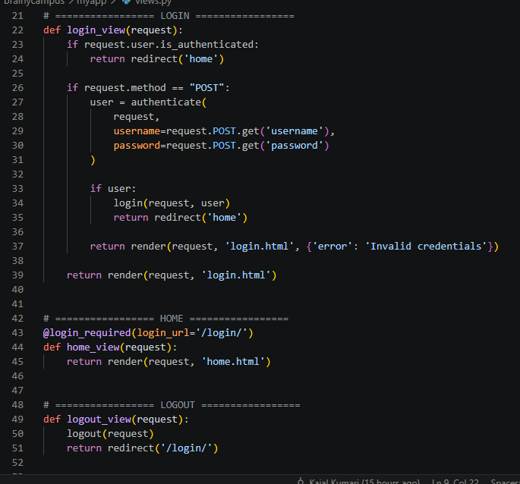
Coding & Implementation:
views.py File

Slide 12
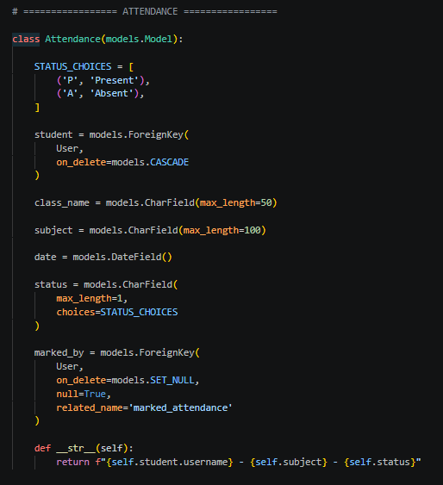
models.py:
Attendance Model

Slide 13
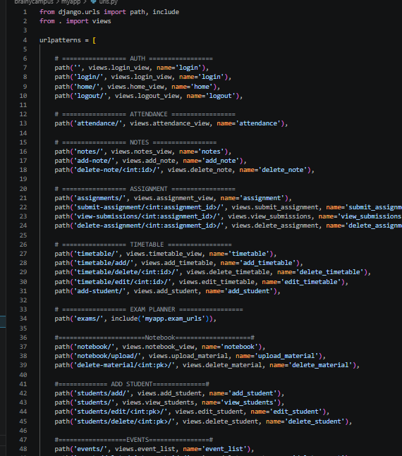
urls.py
URL Routing Paths

Slide 14
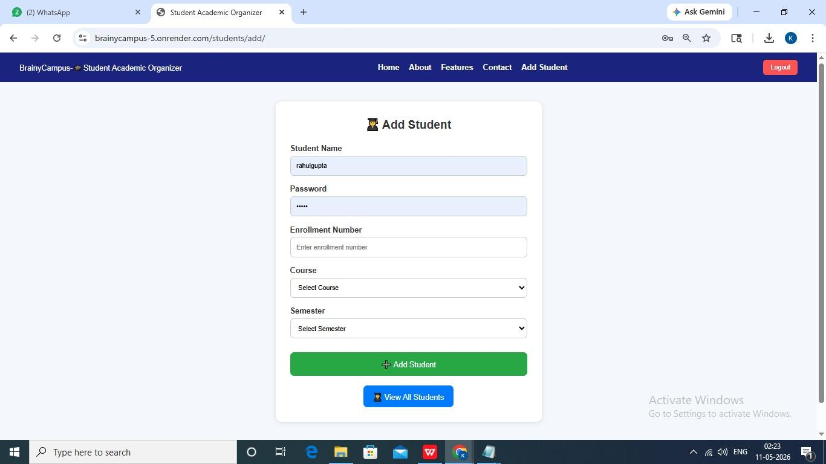
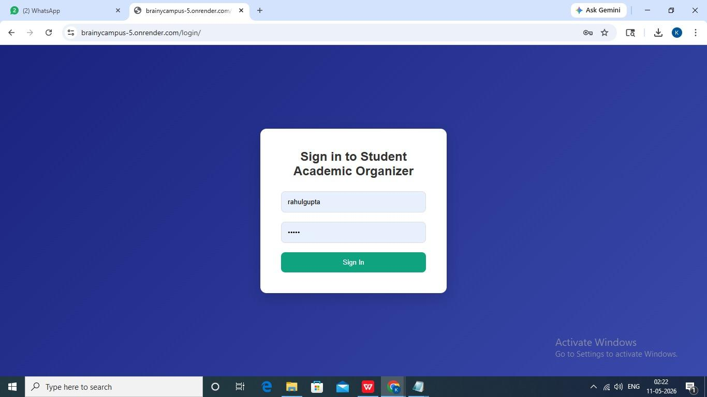
SCREENSHOTS AND RESULTS

Slide 15
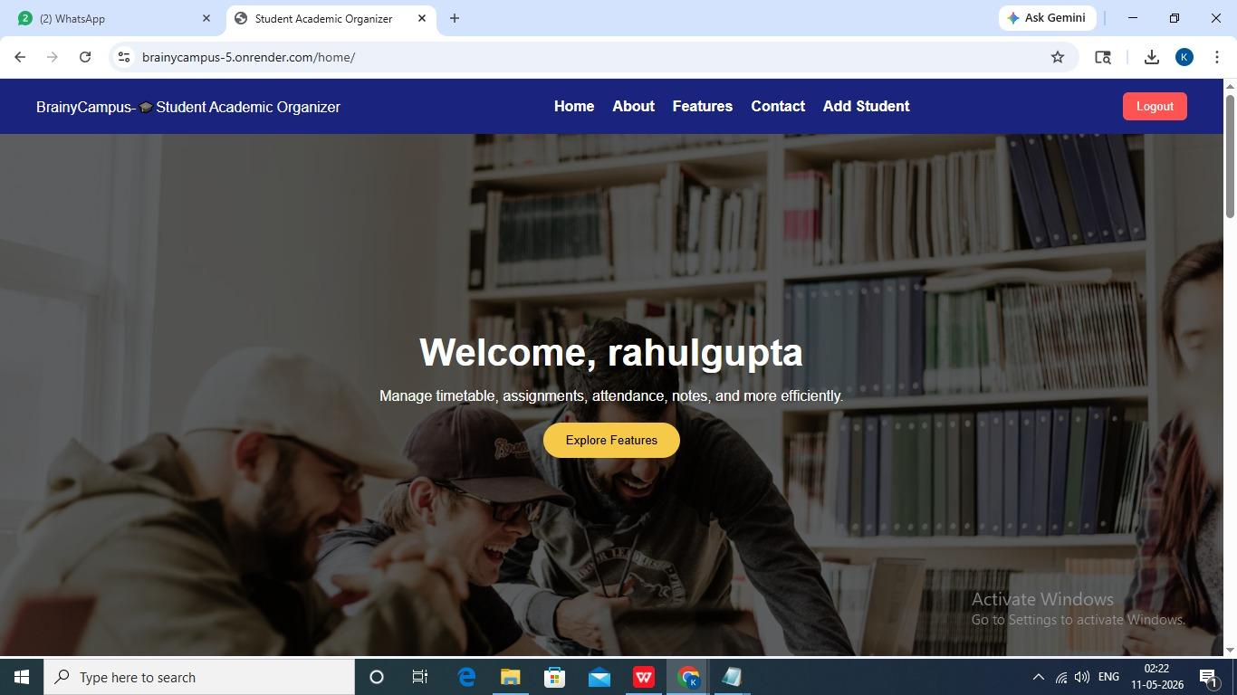

Slide 16
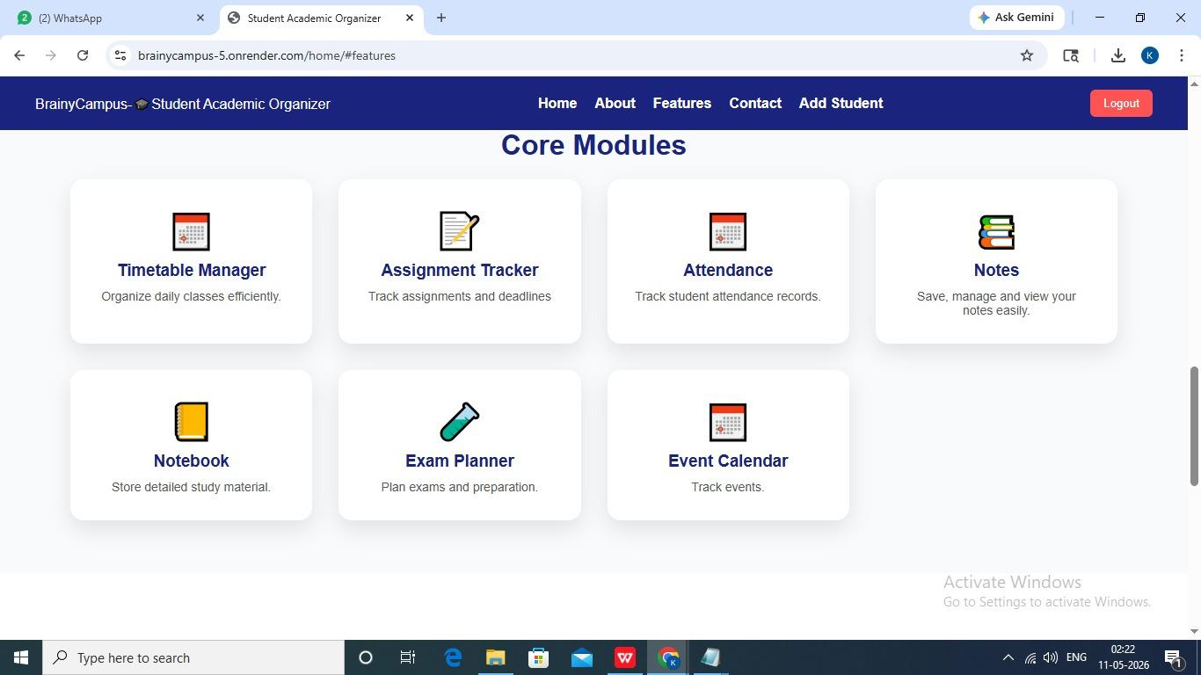

Slide 17
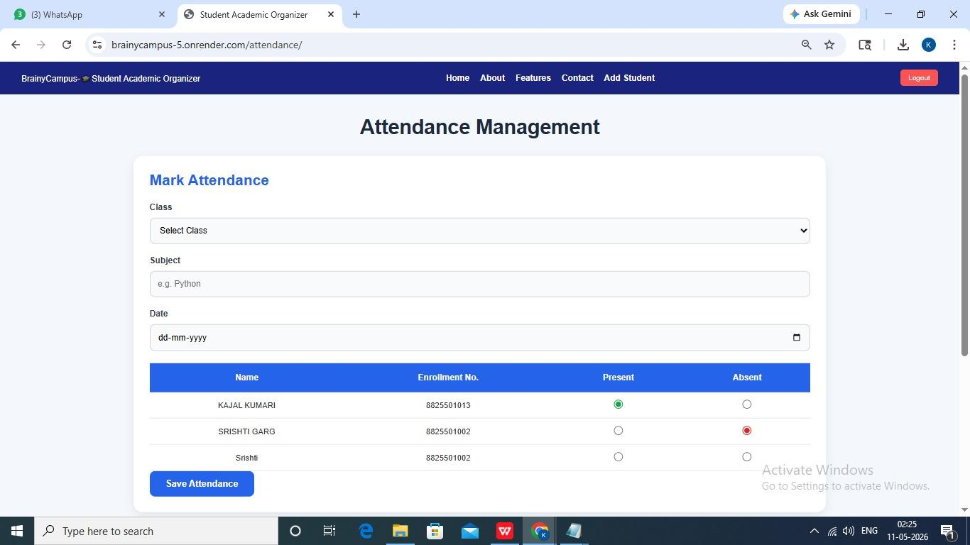

Slide 18
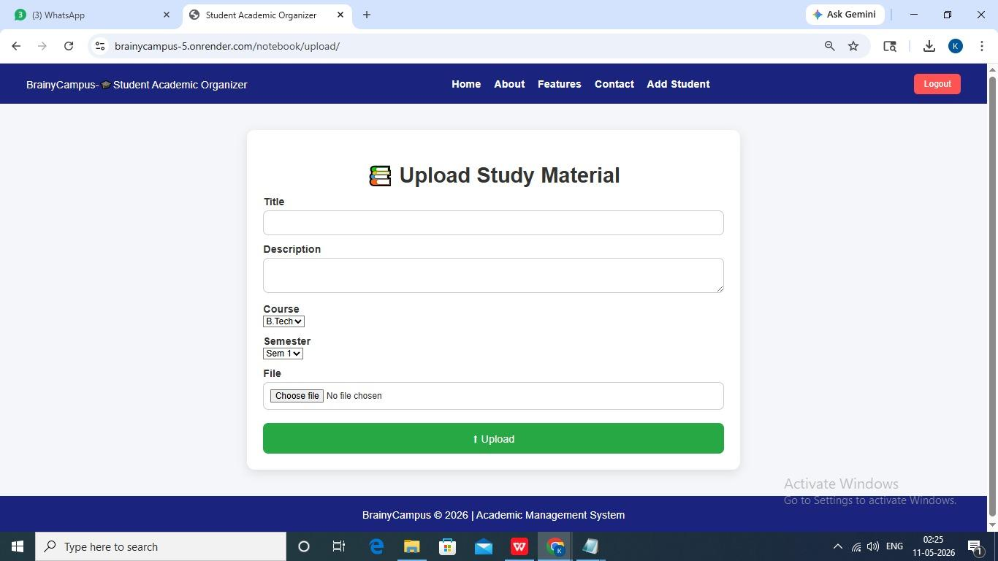
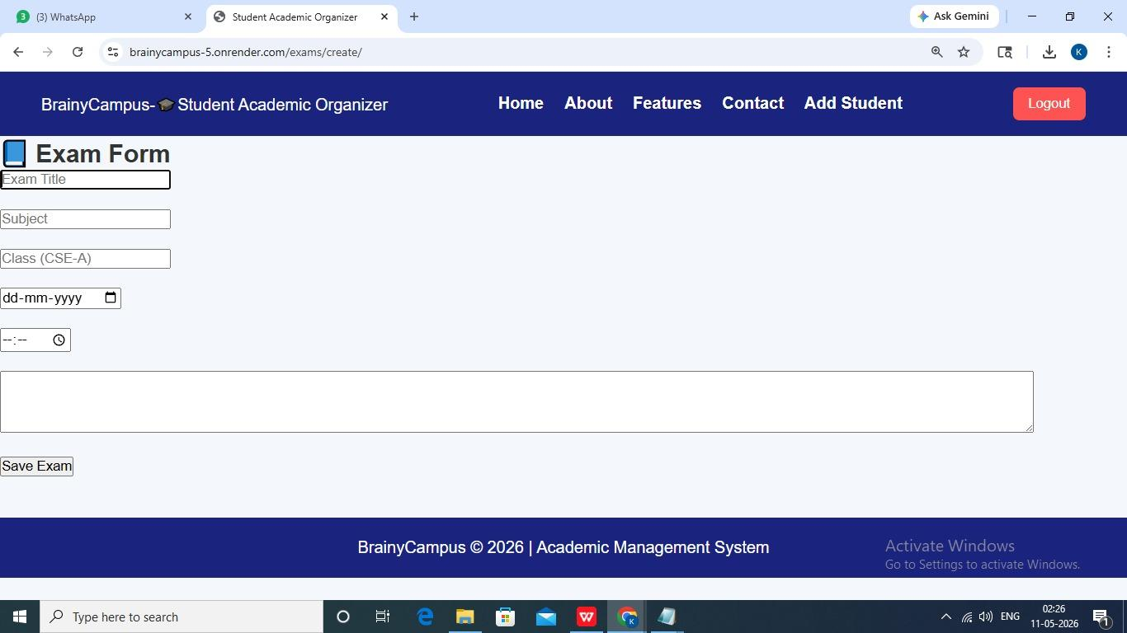

Slide 19
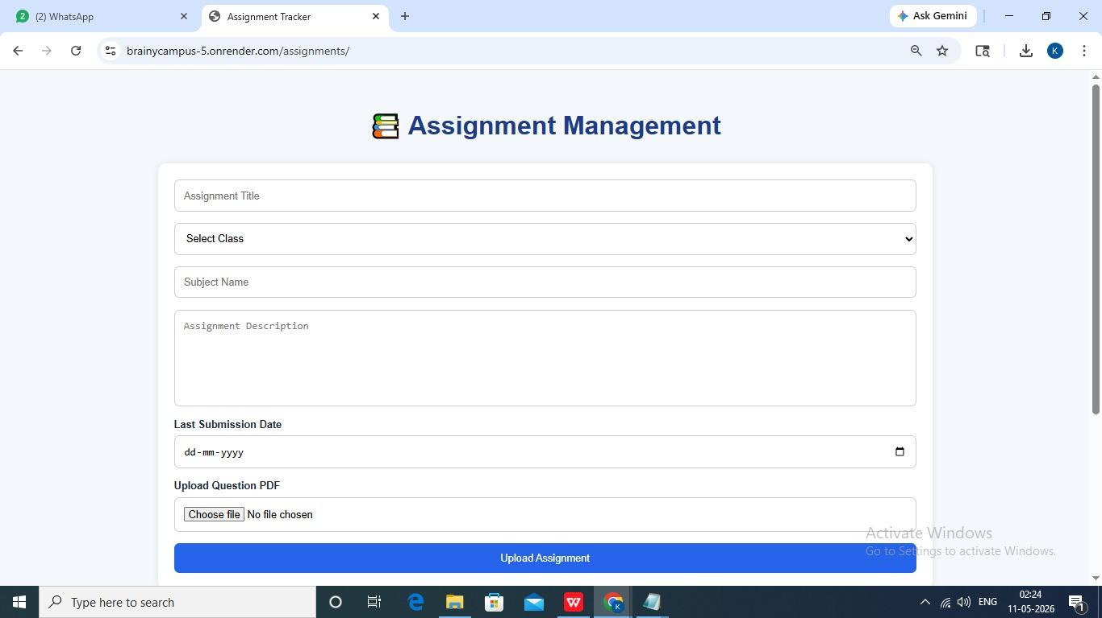

Slide 20
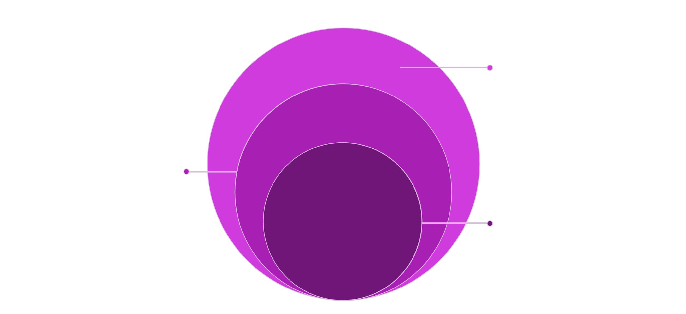
Three-Tier System Architecture
The BrainyCampus architecture follows a clean MVC pattern — user requests flow through Django's authentication layer into the dashboard, which routes to individual modules backed by SQLite3.
Data & Output
SQLite3 database powering output display
Application Layer
Module selection, Dashboard, Authentication
Core Modules
Attendance, Assignments, Notes, Timetable, Exams, Events
Each layer is independently maintainable, making the system extensible for future modules such as mobile APIs or cloud storage without restructuring the core.

Slide 21


Future Enhancements
Roadmap Ahead
Mobile application
Native iOS and Android apps for on-the-go access.
AI study assistant
Personalised recommendations and smart reminders.
Cloud database
Migrate from SQLite3 to PostgreSQL on cloud infrastructure.
Online examinations
Integrated proctored exam support within the platform.

Slide 22
Conclusion
Brainy Campus demonstrates that a well-architected, full-stack web application can meaningfully modernise academic administration. The system delivers a centralised, secure, and scalable solution — replacing fragmented manual processes with an efficient digital workflow.
Centralised
Secure
All academic data in one unified system
Role-based access with session management
Scalable
Impactful
Architecture ready for future expansion
Measurable improvement in productivity

Slide 23


